Slide 1
Object-Oriented Software Engineering
Practical Software Development using UML and Java
Chapter 6:
Using Design Patterns

Slide 2
6.1 Introduction to Patterns
The recurring aspects of designs are called design patterns.
  A pattern is the outline of a reusable solution to a general problem encountered in a particular context
  Many of them have been systematically documented for all software developers to use
  A good pattern should
    Be as general as possible
    Contain a solution that has been proven to effectively solve the problem in the indicated context.
  Studying patterns is an effective way to learn from the experience of others

Slide 3
Pattern description
  Context:
    The general situation in which the pattern applies
  Problem:
    A short sentence or two raising the main difficulty.
  Forces:
    The issues or concerns to consider when solving the problem
  Solution:
    The recommended way to solve the problem in the given context.
      ‘to balance the forces’
  Antipatterns: (Optional)
    Solutions that are inferior or do not work in this context.
  Related patterns: (Optional)
    Patterns that are similar to this pattern.
  References:
    Who developed or inspired the pattern.

Slide 4
6.2 The Abstraction-Occurrence Pattern
  Context:
    Often in a domain model you find a set of related objects (occurrences).
    The members of such a set share common information
      but also differ from each other in important ways.
  Problem:
    What is the best way to represent such sets of occurrences in a class diagram?
  Forces:
    You want to represent the members of each set of occurrences without duplicating the common information

Slide 5
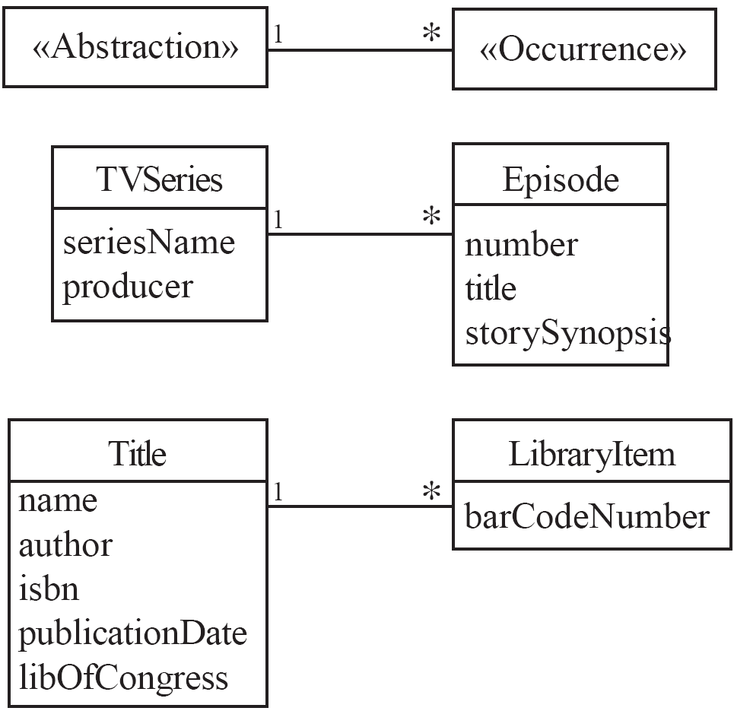
Abstraction-Occurrence
  Solution:

Slide 6
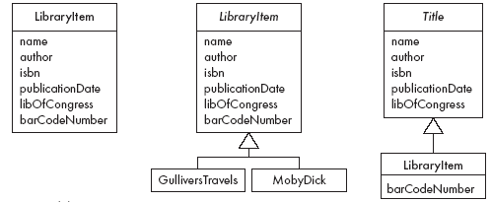
Abstraction-Occurrence
Antipatterns:

Slide 7
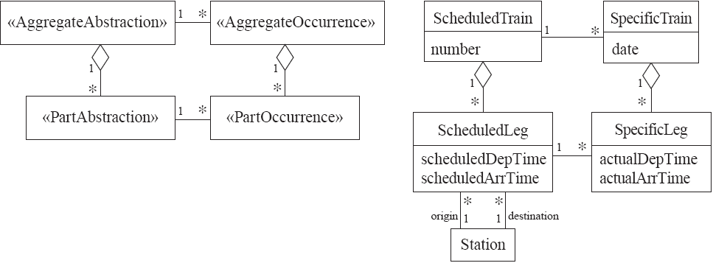
Abstraction-Occurrence
Square variant

Slide 8
6.3 The General Hierarchy Pattern
  Context:
    Objects in a hierarchy can have one or more objects above them (superiors),
      and one or more objects below them (subordinates).
    Some objects cannot have any subordinates
  Problem:
    How do you represent a hierarchy of objects, in which some objects cannot have subordinates?
  Forces:
    You want a flexible way of representing the hierarchy
      that prevents certain objects from having subordinates
    All the objects have many common properties and operations

Slide 9
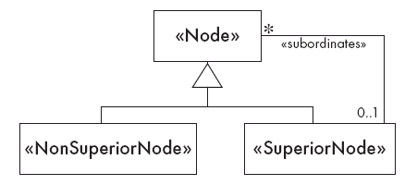
General Hierarchy
  Solution:

Slide 10
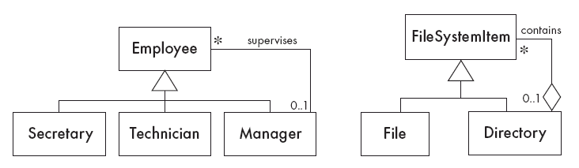
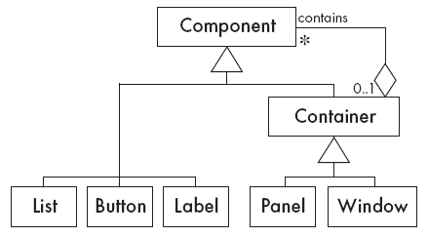
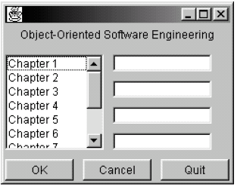
General Hierarchy
  Solution:

Slide 11
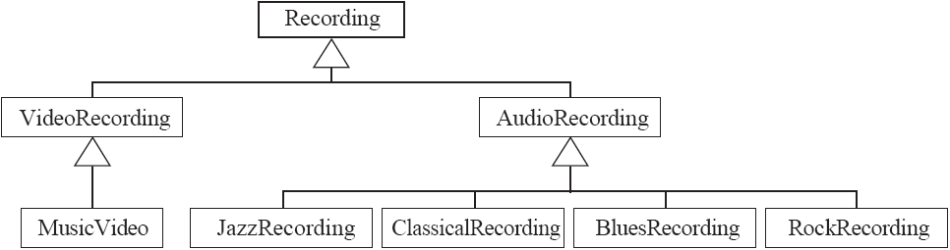
General Hierarchy
Antipattern:

Slide 12
6.4 The Player-Role Pattern
  Context:
    A role is a particular set of properties associated with an object in a particular context.
    An object may play different roles in different contexts.
  Problem:
    How do you best model players and roles so that a player can change roles or possess multiple roles?

Slide 13
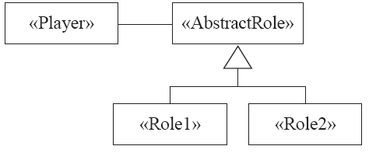
Player-Role
  Forces:
    It is desirable to improve encapsulation by capturing the information associated with each separate role in a class.
    You want to avoid multiple inheritance.
    You cannot allow an instance to change class
  Solution:

Slide 14
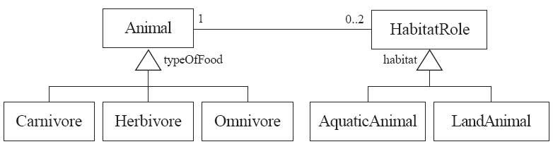
Player-Role
Example 1:

Slide 15
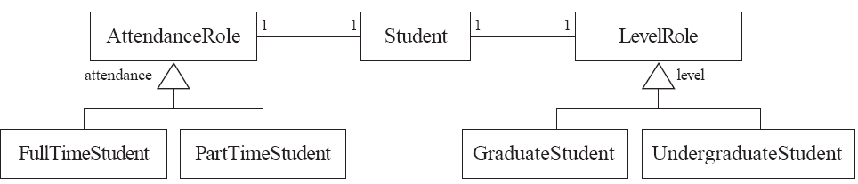
Player-Role
Example 2:

Slide 16
Player-Role
Antipatterns:
  Merge all the properties and behaviours into a single «Player» class and not have «Role» classes at all.
  Create roles as subclasses of the «Player» class.

Slide 17
6.5 The Singleton Pattern
  Context:
    It is very common to find classes for which only one instance should exist (singleton)
  Problem:
    How do you ensure that it is never possible to create more than one instance of a singleton class?
  Forces:
    The use of a public constructor cannot guarantee that no more than one instance will be created.
    The singleton instance must also be accessible to all classes that require it

Slide 18
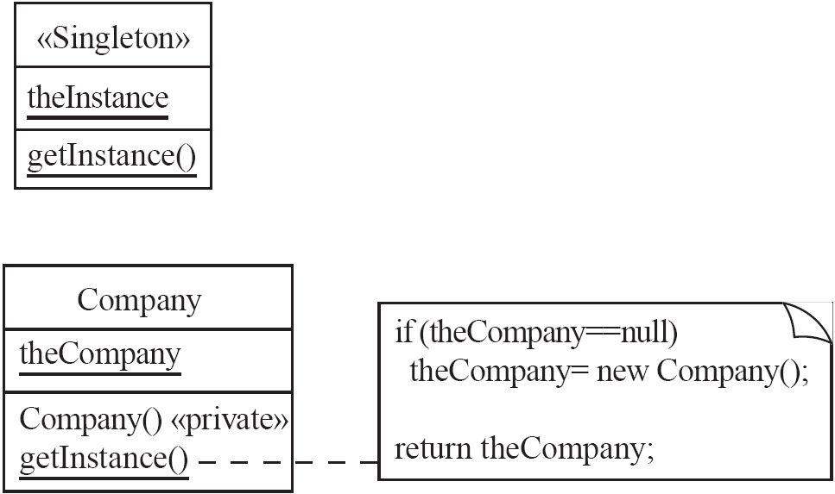
Singleton
  Solution:

Slide 19
6.6 The Observer Pattern
  Context:
    When an association is created between two classes, the code for the classes becomes inseparable.
    If you want to reuse one class, then you also have to reuse the other.
  Problem:
    How do you reduce the interconnection between classes, especially between classes that belong to different modules or subsystems?
  Forces:
    You want to maximize the flexibility of the system to the greatest extent possible

Slide 20
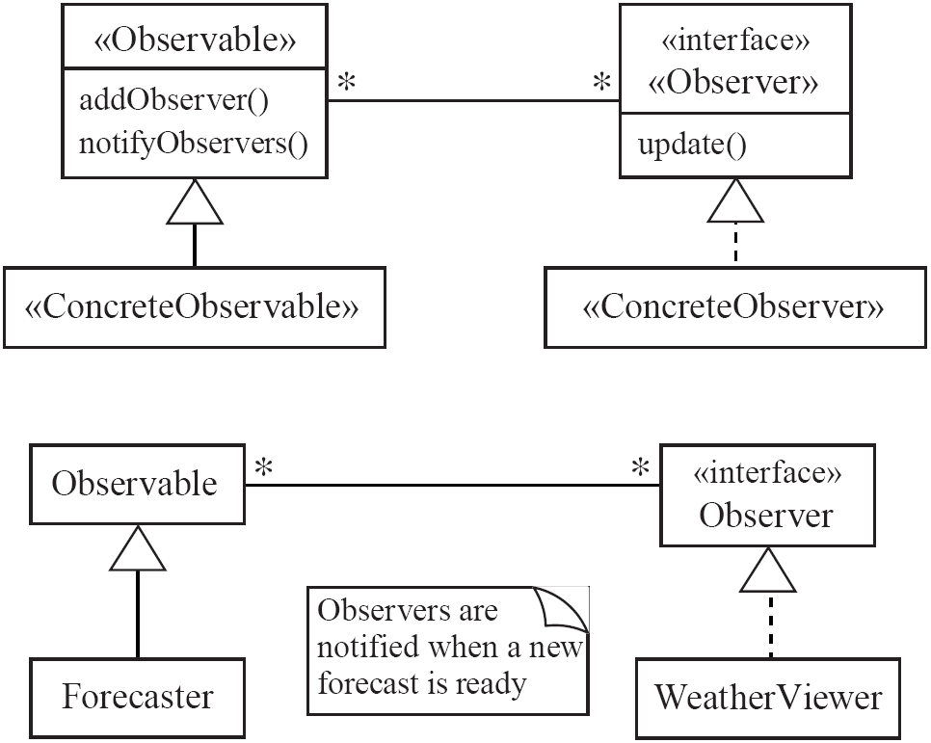
Observer
  Solution:

Slide 21
Observer
Antipatterns:
  Connect an observer directly to an observable so that they both have references to each other.
  Make the observers subclasses of the observable.

Slide 22
6.7 The Delegation Pattern
  Context:
    You are designing a method in a class
    You realize that another class has a method which provides the required service
    Inheritance is not appropriate
      E.g. because the isa rule does not apply
  Problem:
    How can you most effectively make use of a method that already exists in the other class?
  Forces:
    You want to minimize development cost by reusing methods

Slide 23
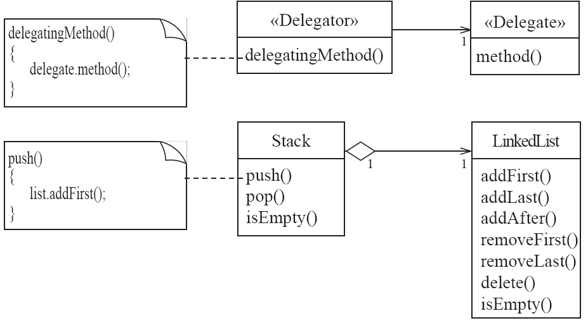
Delegation
  Solution:

Slide 24
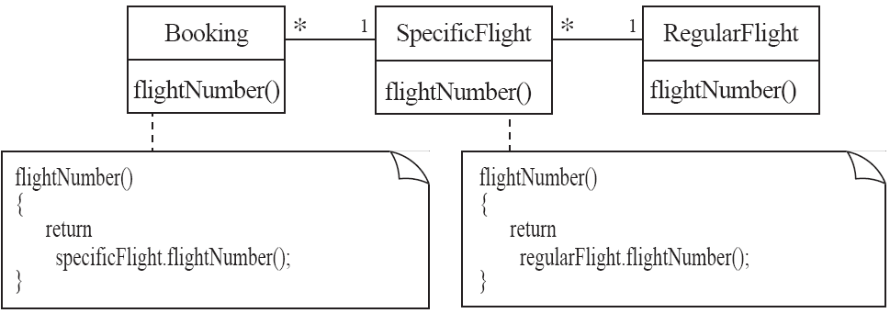
Delegation
Example:

Slide 25
Delegation
Antipatterns
  Overuse generalization and inherit the method that is to be reused
  Instead of creating a single method in the «Delegator» that does nothing other than call a method in the «Delegate
    consider having many different methods in the «Delegator» call the delegate’s method
  Access non-neighboring classes
return specificFlight.regularFlight.flightNumber();
return getRegularFlight().flightNumber();

Slide 26
6.8 The Adapter Pattern
  Context:
    You are building an inheritance hierarchy and want to incorporate it into an existing class.
    The reused class is also often already part of its own inheritance hierarchy.
  Problem:
    How to obtain the power of polymorphism when reusing a class whose methods
      have the same function
      but not the same signature
    as the other methods in the hierarchy?
  Forces:
    You do not have access to multiple inheritance or you do not want to use it.

Slide 27
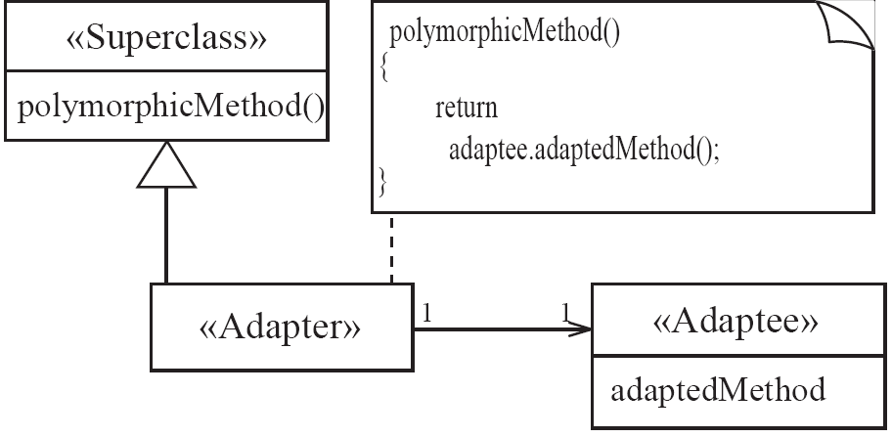
Adapter
  Solution:

Slide 28
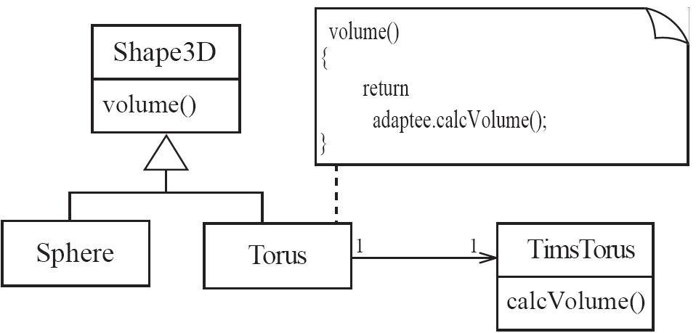
Adapter
Example:

Slide 29
6.9 The Façade Pattern
  Context:
    Often, an application contains several complex packages.
    A programmer working with such packages has to manipulate many different classes
  Problem:
    How do you simplify the view that programmers have of a complex package?
  Forces:
    It is hard for a programmer to understand and use an entire subsystem
    If several different application classes call methods of the complex package, then any modifications made to the package will necessitate a complete review of all these classes.

Slide 30
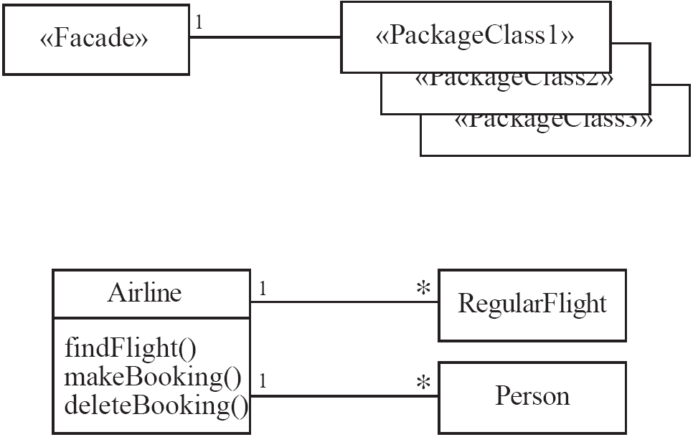
Façade
  Solution:

Slide 31
6.10 The Immutable Pattern
  Context:
    An immutable object is an object that has a state that never changes after creation
  Problem:
    How do you create a class whose instances are immutable?
  Forces:
    There must be no loopholes that would allow ‘illegal’ modification of an immutable object
  Solution:
    Ensure that the constructor of the immutable class is the only place where the values of instance variables are set or modified.
    Instance methods which access properties must not have side effects.
    If a method that would otherwise modify an instance variable is required, then it has to return a new instance of the class.

Slide 32
6.11 The Read-only Interface Pattern
  Context:
    You sometimes want certain privileged classes to be able to modify attributes of objects that are otherwise immutable
  Problem:
    How do you create a situation where some classes see a class as read-only whereas others are able to make modifications?
  Forces:
    Restricting access by using the public, protected and private keywords is not adequately selective.
    Making access public makes it public for both reading and writing

Slide 33
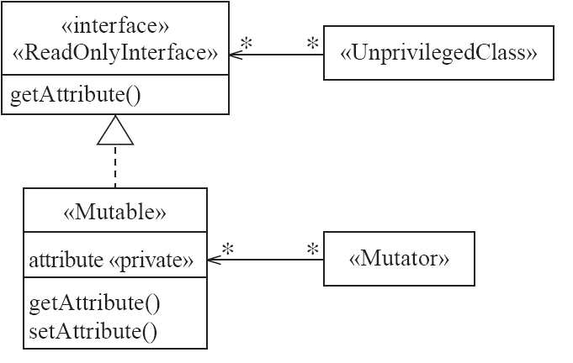
Read-only Interface
  Solution:

Slide 34
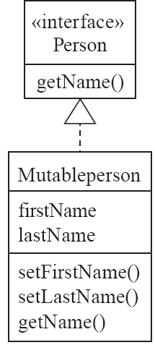
Read-only Interface
Example:

Slide 35
Read-only Interface
Antipatterns:
  Make the read-only class a subclass of the «Mutable» class
  Override all methods that modify properties
    such that they throw an exception

Slide 36
6.12 The Proxy Pattern
  Context:
    Often, it is time-consuming and complicated to create instances of a class (heavyweight classes).
    There is a time delay and a complex mechanism involved in creating the object in memory
  Problem:
    How to reduce the need to create instances of a heavyweight class?
  Forces:
    We want all the objects in a domain model to be available for programs to use when they execute a system’s various responsibilities.
    It is also important for many objects to persist from run to run of the same program

Slide 37
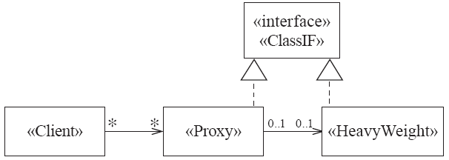
Proxy
  Solution:

Slide 38
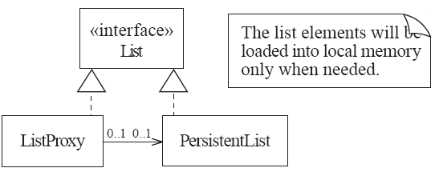
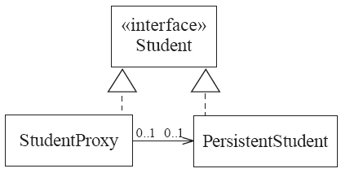
Proxy
Examples:

Slide 39
6.13 The Factory Pattern
  Context:
    A reusable framework needs to create objecs; however the class of the created objects depends on the application.
  Problem:
    How do you enable a programmer to add new application-specific class into a system built on such a framework?
  Forces:
    We want to have the framework create and work with application-specific classes that the framework does not yet know about.
  Solution:
    The framework delegates the creation of application-specific classes to a specialized class, the Factory.
    The Factory is a generic interface defined in the framework.
    The factory interface declares a method whose purpose is to create some subclass of a generic class.

Slide 40
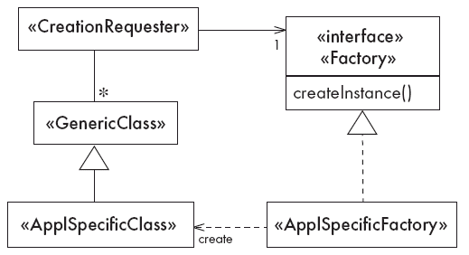
The Factory Pattern
Solution

Slide 41
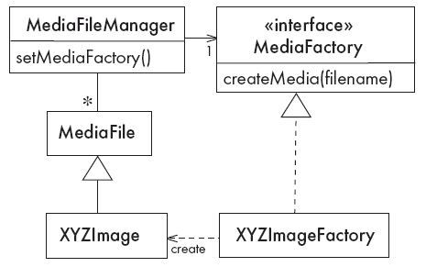
The Factory Pattern
Example

Slide 42
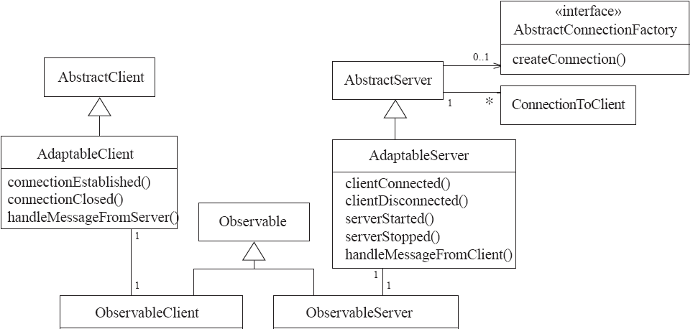
6.14 Detailed Example: enhancing OCSF with some design patterns

Slide 43
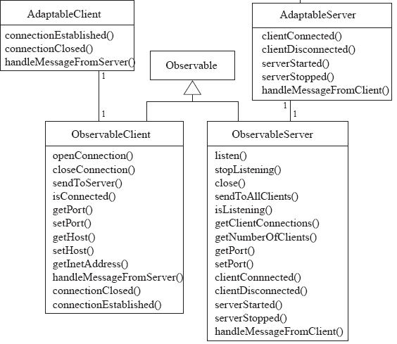
The Observable layer of OCSF (continued)

Slide 44
Using the observable layer
1. Create a class that implements the Observer interface.
2. Register it as an observer of the Observable:
public MessageHandler(Observable client)
{
client.addObserver(this);
...
}
3. Define the update method in the new class:
public void update(Observable obs, Object message)
{
if (message instanceOf SomeClass)
{
// process the message
}
}

Slide 45
6.15 Difficulties and Risks When Creating Class Diagrams
  Patterns are not a panacea:
    Whenever you see an indication that a pattern should be applied, you might be tempted to blindly apply the pattern.
    This can lead to unwise design decisions .
  Resolution:
    Always understand in depth the forces that need to be balanced, and when other patterns better balance the forces.
    Make sure you justify each design decision carefully.

Slide 46
Difficulties and Risks When Creating Class Diagrams
  Developing patterns is hard
    Writing a good pattern takes considerable work.
    A poor pattern can be hard to apply correctly
  Resolution:
    Do not write patterns for others to use until you have considerable experience both in software design and in the use of patterns.
    Take an in-depth course on patterns.
    Iteratively refine your patterns, and have them peer reviewed at each iteration.

